Slide 1
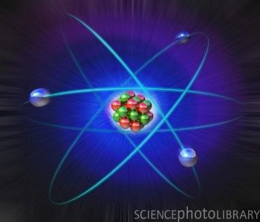
ATOMIC STRUCTURE
  F Y B Sc
Dr.Lalasaheb Kashid, H.O.D. Chemistry

Slide 2
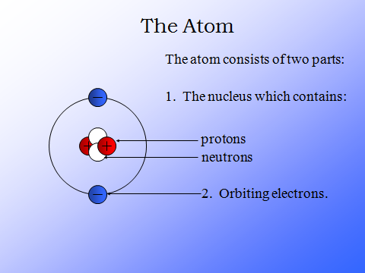
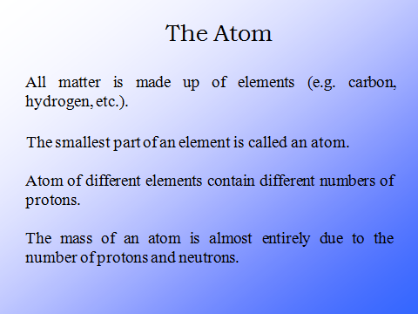
ATOM

Slide 3
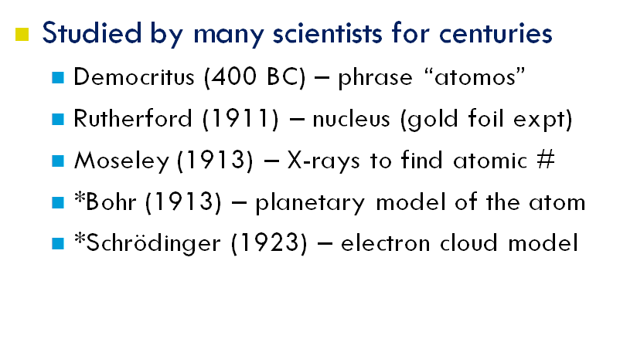
Who studied the atom?

Slide 4

Development of Atomic Models
One of concept of atom was proposed by the ancient Greek philosopher, Democritus. Democritus and his followers believed that every object or matter found in this world is composed by the minute, invisible, indivisible particles called atom. Atom is the simplest and smallest division of an object or matter. The word atom is derived from Greek atomos meaning “unable to be cut”
According to Democritos, atoms are made up of precisely the same matter, but atoms of different elements differ in shape, size, weight, arrangement, and position. The size, shape, and arrangement of atoms of a substance determinethe substance properties.
The followings are descriptions of atomic models development by scientists after Democritus and the modern atomic model believed at the present day.

Slide 5

Dalton’s Atomic Model
In the early 19-th century (1808), a British chemist and physicist “John Dalton” (1766-1844) studied thoroughly how different elements, such as hydrogen and oxygen, could combine to form another substance ex. water. Dalton made two assertions about atoms, which is :
Atoms of each element are all identical to one another, but different from the atoms of all other elements
Atom of different elements can combine to form more complex substances

Slide 6
Dalton’s Atomic Theory (experiment based)
All elements are composed of tiny indivisible particles called atoms
Atoms of the same element are identical. Atoms of any one element are different from those of any other element.
Atoms of different elements combine in simple whole-number ratios to form chemical compounds
In chemical reactions, atoms are combined, separated, or rearranged – but never changed into atoms of another element.

Slide 7
Limitations of Dalton’s atomic theory
According to Dalton’s atomic theory atoms combine in the ratio of small whole numbers to form compounds. This is not seen in complex organic compounds like sugar C12H22O11. Ratio of C, H and O is 12:22:11 which is not simple.

Slide 8

Thomson’s Atomic Model
Since the discovery of electron as an elementary particle which is negatively charged, the validity of Dalton’s atomic theory begans to be questionable. In 1899, a british physicist, Sir Joseph Thomson, proposed :
An atomic model callaed raisin plum pudding model.
Thomson described atom as a positively charged sphere containing several negatively charged particles called electrons. Electrons are scattered in the sphere like raisins in a plum pudding
-
+
+
-
-
-
+
+

Slide 9
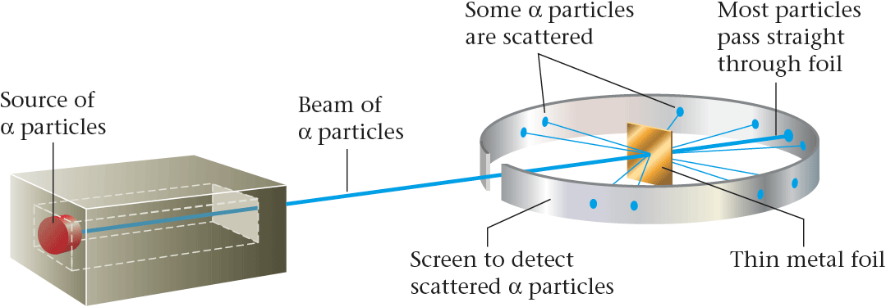
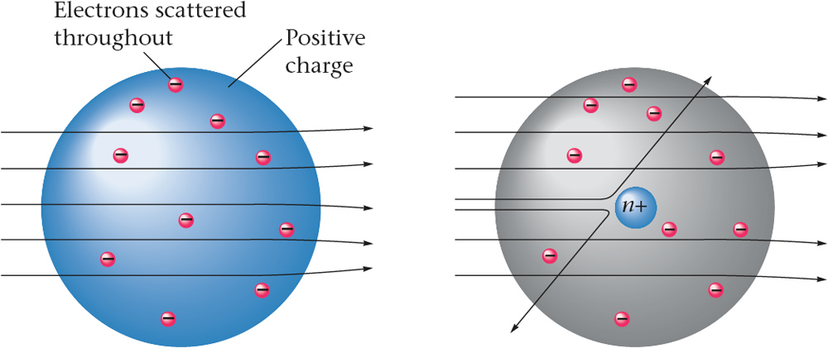
  Rutherford’s Experiment
Observations
(i) most of the α– particles passed through the gold foil undeflected.
(ii) a small fraction of the α–particles was deflected by small angles.
(iii) a very few α– particles (∼1 in 20,000) bounced back, that is, were deflected by nearly 180°.
Conclusions
1.Most of the space in the atom is empty
2. The positive charge has to be concentrated in a very small volume
that repelled and deflected the positively
charged α– particles
3.Rutherford showed that the volume occupied by the nucleus is negligibly small as compared to the total volume of the atom. The radius of the atom is about 10–10 m, while that of nucleus is 10–15 m.

Slide 10

Rutherford’s Atomic Model
In 1911, Ernest Rutherford. Geiger and Marsden carried out an experiment by shooting the particles (α) on a thin plate of gold to prove the Thomson’s atomic theory or model as follows
An atom consists of an atomic nucleus which is positively charged. The nucleus of atom contains almost entire mass of the atom and is surrounded by electrons which are negatively charged as in the solar system model
Entirely, an atom is neutral because the number of its positive charges (protons) is equal to that of its negative charges.
During revolving the nucleus, the centripetal force on electrons in an atom is produced by the forces of attraction between the electrons and nucleus ( coulomb force )

Slide 11
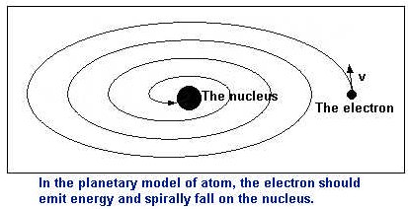
Defects in Rutherford’s model of atom
(i) When electron (Negatively charged particle) revolve continuously around the positively charged nucleus then energy would be lost and due to the attraction of nucleus electron will merge with the nucleus. Rutherford has no explanation for this problem.
(ii) If electron will continuously radiate energy then its spectra should be continuous but this is not the case. Atoms give line
spectra.
In order to overcome the defects of Rutherford Neil Bohr proposed the atomic model.

Slide 12
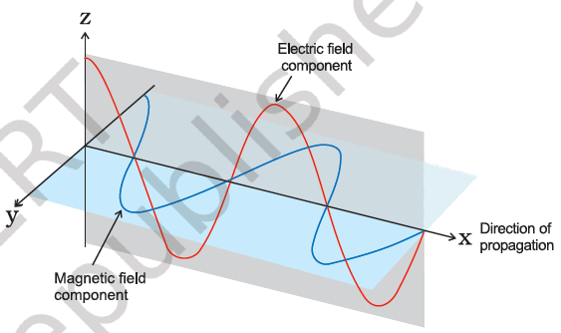
ELECTROMAGNETIC RADIATIONS
Electromagnetic Radiations are waves which are formed as a result of oscillating magnetic and electric fields which are perpendicular to each other and both are perpendicular to direction of motion.
They do not require any medium and can move in vacuum unlike sound waves. Light is a form of radiation and has wave characteristics. The various characteristics of a wave are:

Slide 13
1) Amplitude : It is height of the crest or trough (depth) of a wave.
Units : metre (m)
2) Frequency : The number of waves passing through a point in one second. Units : Hertz (Hz) or s–1
3) Time Period : The time taken by a wave to complete one vibration is called time period. Units : sec
4) Velocity : The distance travelled by a wave in one second is called velocity.
Units : m/s
In vacuum, all types of electromagnetic radiations travel at the same speed i.e. 3 × 108 m/s. This is called speed of light.
5) Wavelength : The distance between two adjacent crests or troughs is called wavelength. Units : Angstrom(Å) [1 Å=10–10m]
6) Wave Number : It is the number of wavelengths per centimeter of length. Units : m-1
6.1 Relationship between velocity, frequency & wavelength

Slide 14
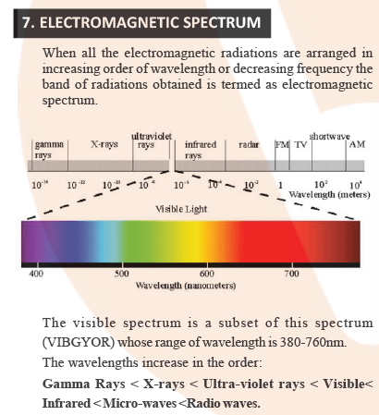

Slide 15
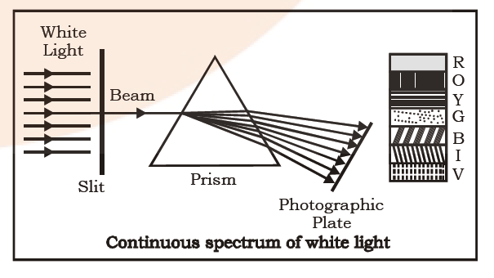
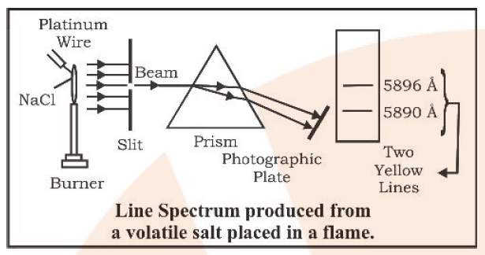
WHAT IS SPECTRUM?
A spectrum is a group or band of wavelengths/colours and the study of emission or absorption spectra is known as spectroscopy.
There are two types of spectrum:
1) Emission Spectrum
2) Absorption Spectrum
Emission Spectrum :When radiations emitted from a source are incident on a prism and are separated into different wavelengths and obtained on a photographic plate.
(a) Continuous Emission Spectra: There are no gaps between various wavelengths, one
wavelength merges into another.
(b) Discontinuous Emission Spectra: It is also known as Line Spectra or atomic spectra.
In this, certain wavelengths go missing from a group and that leaves dark spaces in between giving discontinuity to the spectrum. It is also known as fingerprint of an element.

Slide 16
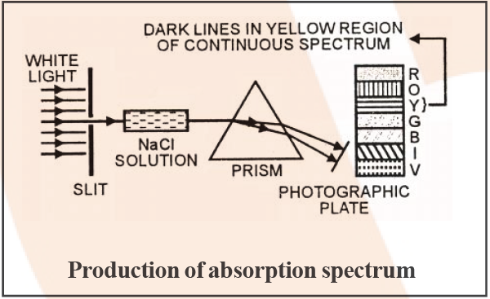
Absorption Spectra : When light from any source is first passed through the solution of a chemical substance and then analysed, it is observed that there are some dark lines in the otherwise continuous spectra.

Slide 17
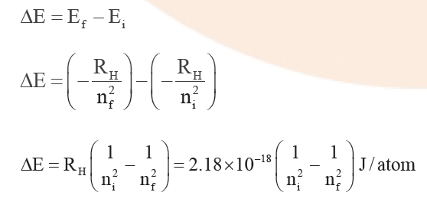
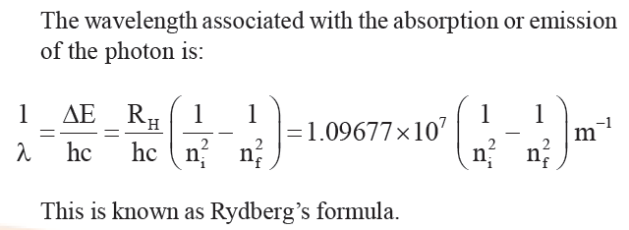
Transition of Electron
We know that energy is absorbed or emitted when electron excites or de-excites respectively. The energy gap between the two orbits is

Slide 18
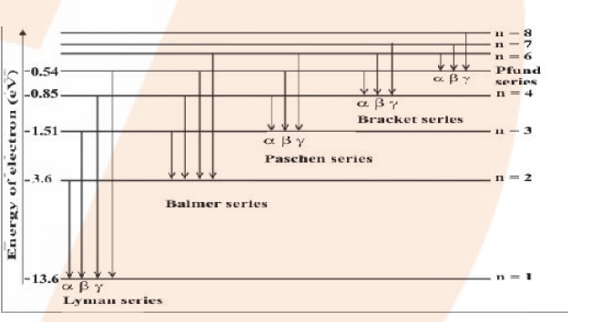
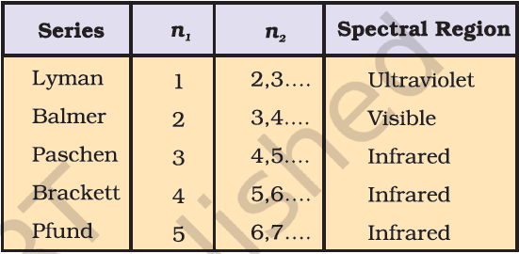
Line Spectrum of Hydrogen
When an electric discharge is passed through gaseous hydrogen, the H2 molecules dissociate and the energetically excited hydrogen atoms produced emit electromagnetic radiations of discrete frequency. The hydrogen spectra consists of several lines named after their discoverer. We get discrete lines and not a continuous spectra because the energy of an electron cannot change continuously but can have only definite values. Thus we can say that energy of an electron is quantised.

Slide 19
LYMAN SERIES :
When an electron jumps from any of the higher states to the ground state or first state (n = 1) ,the series of spectral lines emitted lies in the ultra violet region and are called as Lyman series. Therefore , in Rydberg’s formula n1= 1, n2= 2,3,4,5...
BALMER SERIES :
When an electron jumps from any of the higher states to the state with n=2,the series of spectral lines emitted lies in the visible region and are called as Balmer series.
Therefore , in Rydberg’s formula n1= 2, n2= 3,4,5,6....
PASCHEN SERIES :
When an electron jumps from any of the higher states to the state with n=3 ,the series of spectral lines emitted lies in the infrared region and are called as Paschen series.
Therefore , in Rydberg’s formula n1= 3, n2= 4,5,6...
BRACKETT SERIES :
When an electron jumps from any of the higher states to the state with n = 4,the series of spectral lines emitted lies in the infrared region and are called as Brackett series.
Therefore , in Rydberg’s formula n1= 4, n2= 5,6,7...
PFUND SERIES :
When an electron jumps from any of the higher states to the state with n = 4,the series of spectral lines emitted lies in the infrared region and are called as Pfund series.
Therefore , in Rydberg’s formula n1= 5, n2= 6,7...

Slide 20
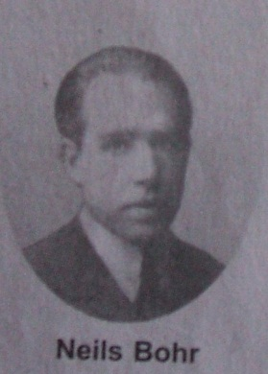
Bohr’s Atomic Model
The weaknesses of Rutherford’s atomic theory in explaining the line spectrum of hydrogen atom was succesfully corerected by a Danish physicist, Neils Bohr, in 1913. Based on the Rutherford’s atomic theory and Planck’s quantum theory, Bohr proposed postulates dealing with an atomic model as follows :
n=3
n=2
n=1
Electrons of an atom revolve around the nucleus at a certain path called stationary path. At This path, the electrons do not absorb or release energy and they have an angular momentum whose magnitude is the multiplication of
Electrons will release energy (in the form photon) if they are moving from a higher to a lower energy level (from outer to the inner path) and the electrons will absorb energy when they are moving from a lower to a higher energi level (from the inner to the outer path)

Slide 21
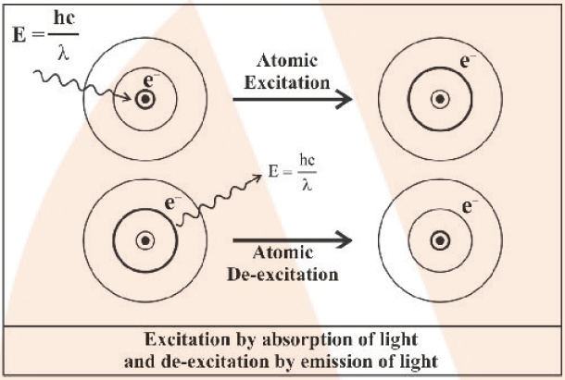
Bohr’s Atomic Model
Bohr’s atomic theory brings about the “Quantum number” concept. The principal quantum number in Bohr’s atomic theory represents the positive integer (n = 1, 2, 3 ….) denoting the electron’s trajectory (orbit) in the atom as well as denoting the energy level of electron.

Slide 22

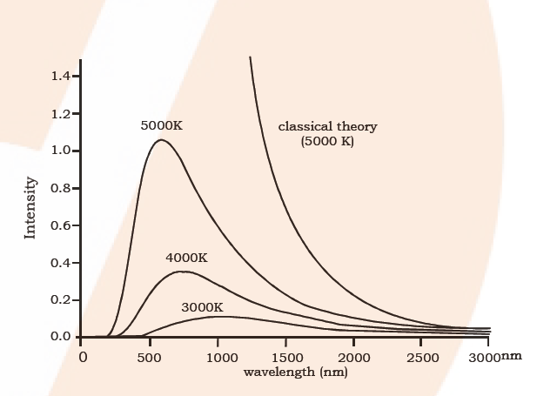
Black Body Radiation :
According to Maxwell’s theory on heating a body the intensity should increase, that is, energy radiated per unit area should increase without having any effect on the wavelength or frequency.
But we observe that when we heat an iron rod, it first turns to red then white and then becomes blue at very high temperatures. This means that frequency of emitted radiations is changing.
An ideal body, which emits and absorbs radiations of all frequencies is called black body and radiation emitted by a black body is called black body radiation
The variation of intensity with wavelength at different temperatures for a black body is shown below:
So it is observed that with increasing temperature the dominant wavelength in the emitted radiations decreases and the frequency increases. That is at higher temperatures, though the intensity rises as predicted by Maxwell’s theory but the wavelength decreases.

Slide 23
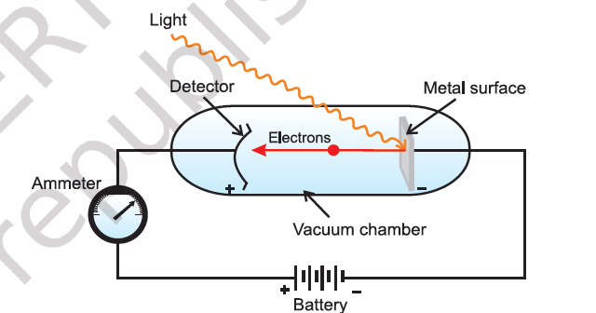
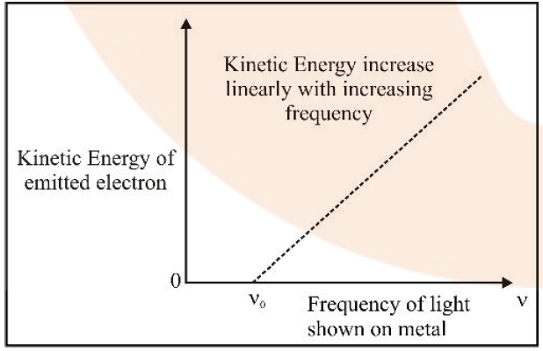
PHOTOELECTRIC EFFECT

Slide 24
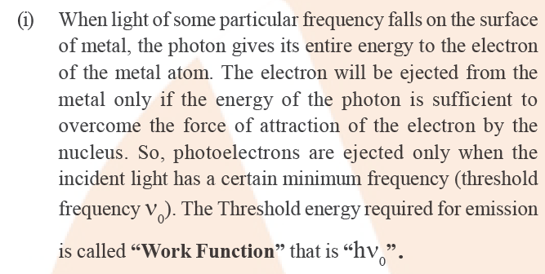
PHOTOELECTRIC EFFECT

Slide 25
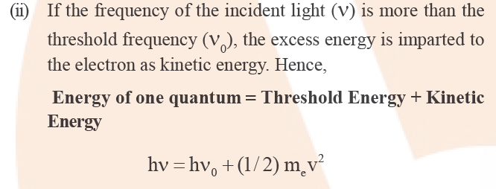
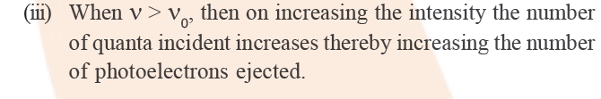

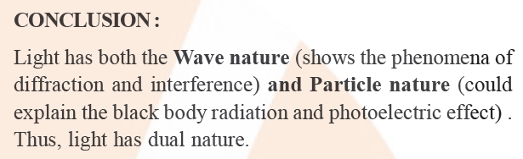
PHOTOELECTRIC EFFECT

Slide 26
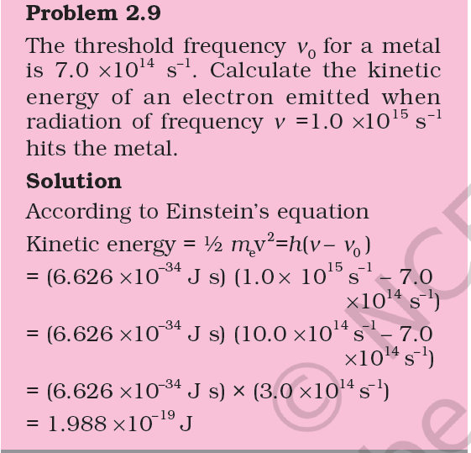
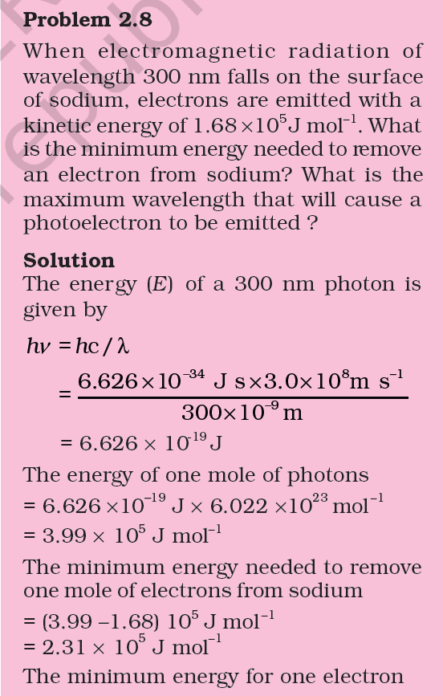
PHOTOELECTRIC EFFECT

Slide 27
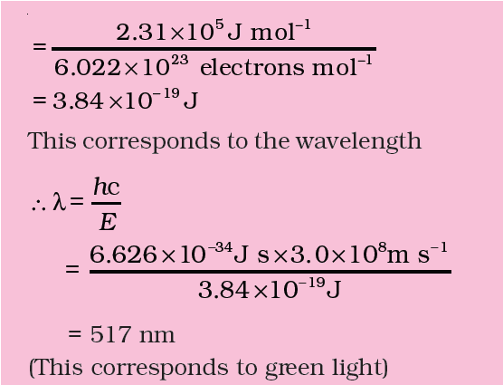
PHOTOELECTRIC EFFECT

Slide 28
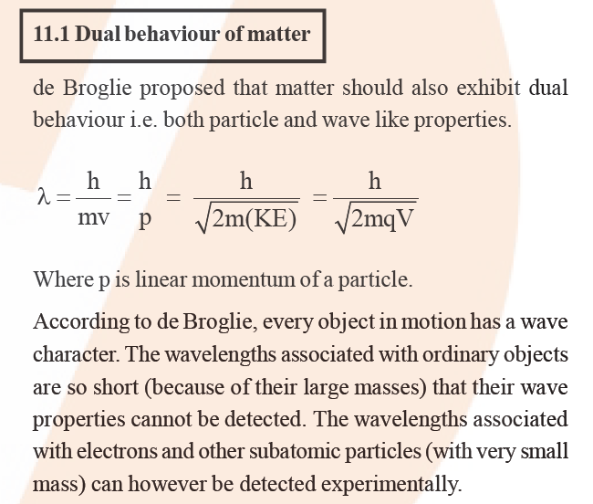
de Broglie Concept of dual nature of matter

Slide 29
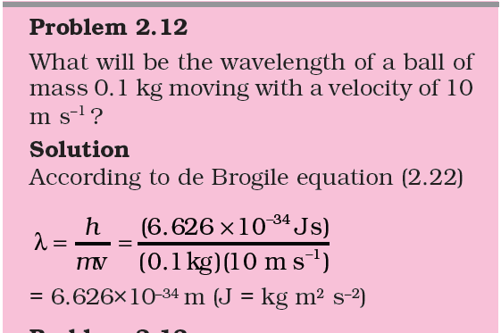
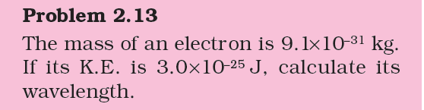
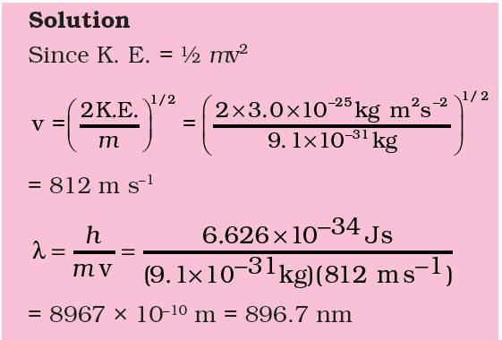
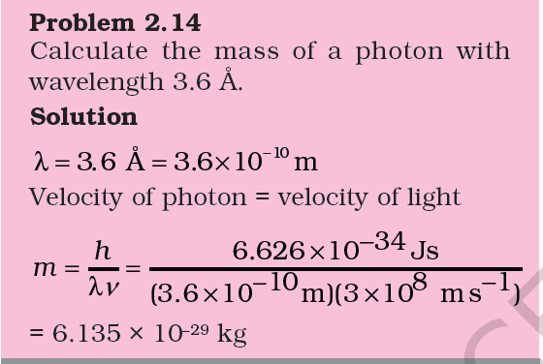
Heisenberg uncertainty Principle

Slide 30
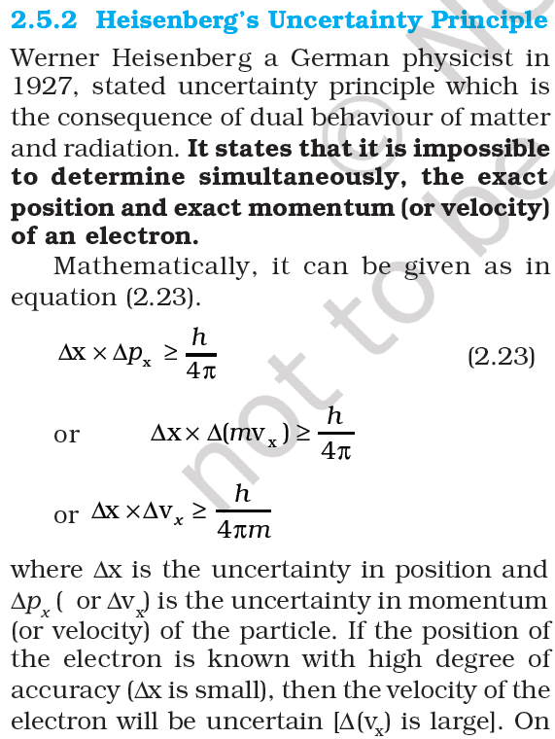
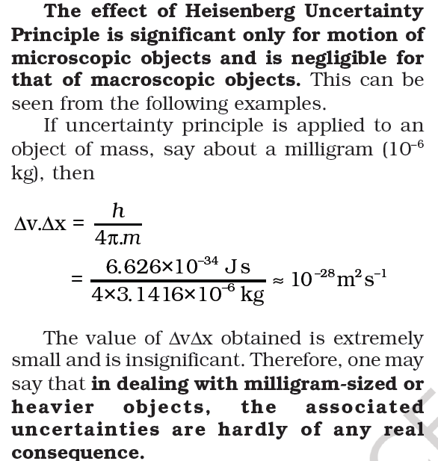
Heisenberg uncertainty Principle

Slide 31
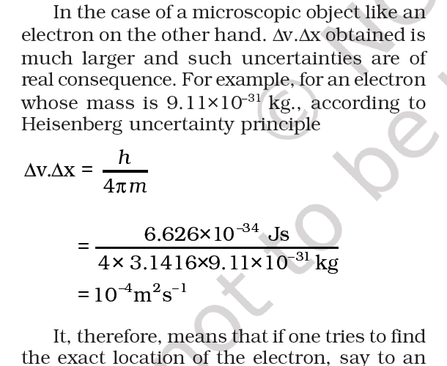
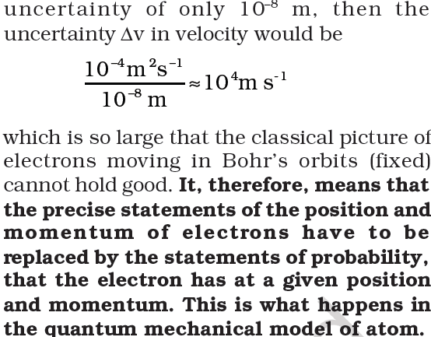
Heisenberg uncertainty Principle

Slide 32
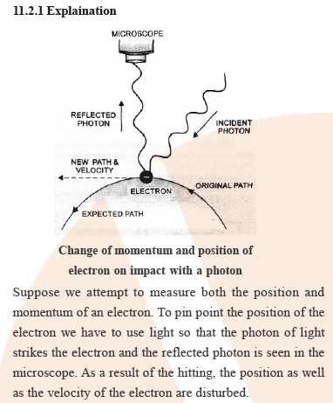
Heisenberg uncertainty Principle

Slide 33
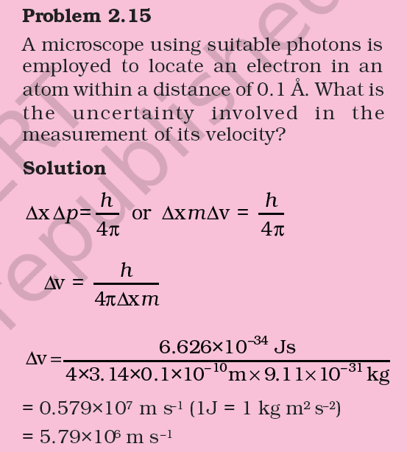
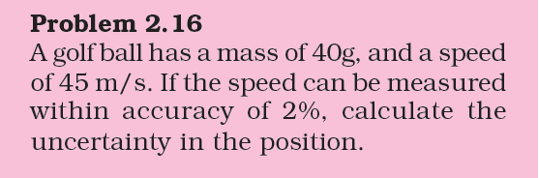
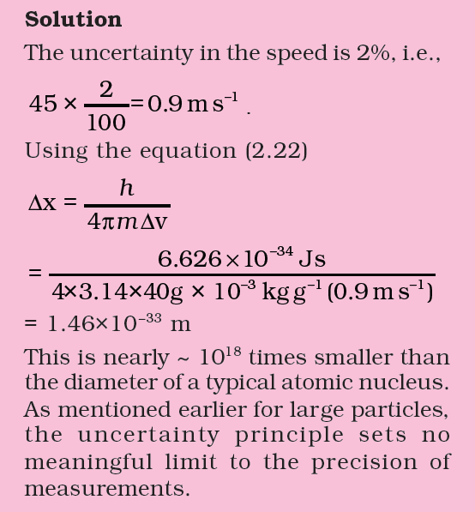
Heisenberg uncertainty Principle

